Slide 1
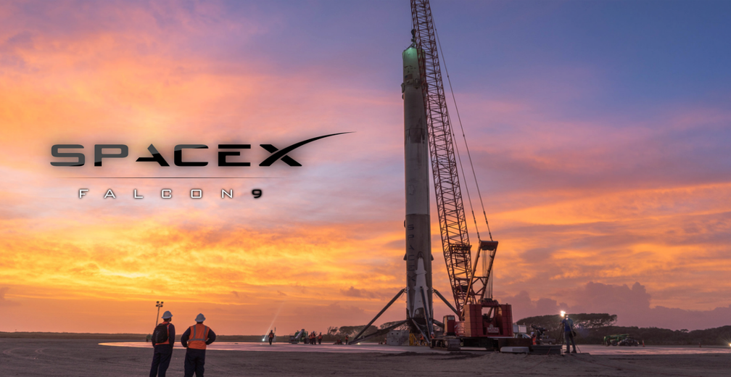
Data Science and Machine Learning Capstone Project ​
By Payas Chatrath

Slide 2



OUTLINE
Executive Summary
Introduction
Results/Methodology
Visualization – Charts
Dashboard
Discussion
Findings & Implications
Conclusion
Appendix
By Payas Chatrath
Last updated: 08/20/2022

Slide 3

EXECUTIVE SUMMARY
Methodology/ Results
Data Collection using API, Web Scraping
Data Wrangling
Exploratory Data Analysis with SQL and Data Visualization
Interactive Visual Analytics
Predicting using Machine Learning models

Slide 4

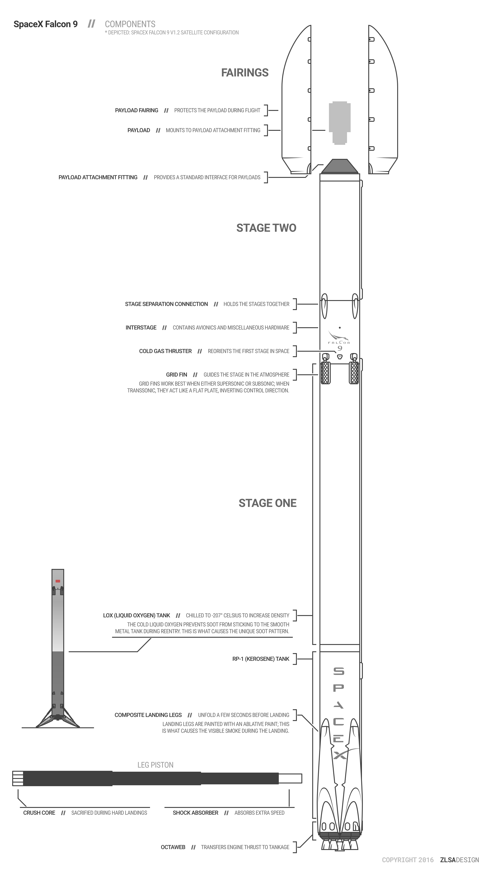
INTRODUCTION
Project
Background: SpaceX advertises Falcon 9 rocket launches on its website with a cost of 62 million dollars; other providers cost upward of 165 million dollars each, much of the savings is because SpaceX can reuse the first stage. Therefore, if we can determine if the first stage will land, we can determine the cost of a launch. This information can be used if an alternate company wants to bid against SpaceX for a rocket launch.
Goal: As a Data Scientist predict if the first stage of Falcon 9 will land successfully or not. The outcome can potentially impact the resources and the cost of the project.
Questions you want to keep in mind
What factors impact the landing status of Falcon 9?
Which model/s can be utilized to derive predictions?

Slide 5

METHODOLOGY EXECUTIVE SUMMARY
Data Collection
The data was collected by the help of SpaceX API and web scarping.
Data Wrangling
One-hot encoding was implemented to help with categorical features.
Exploratory Data Analysis(EDA)
SQL and different visualizations were used.
Visual Analytics
Folium was used to generate maps.
Plotly Dash was used to create a dashboard.
Predictive Analysis
Classification models were used to perform predictions.

Slide 6
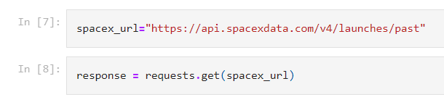
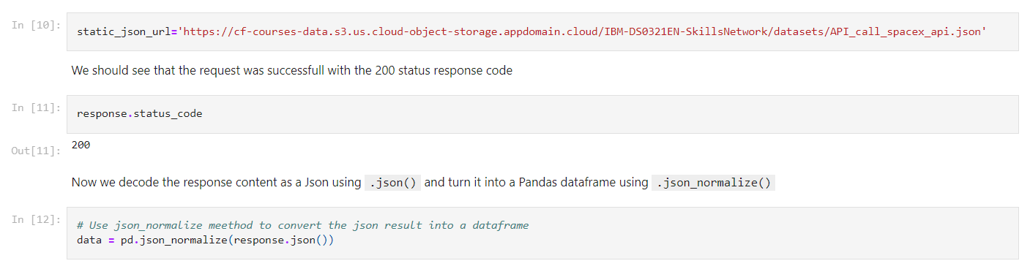
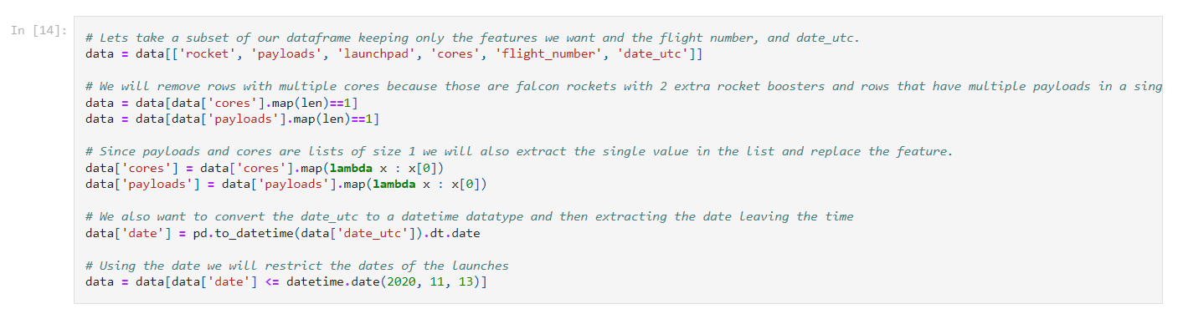
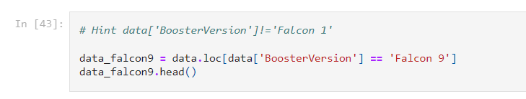
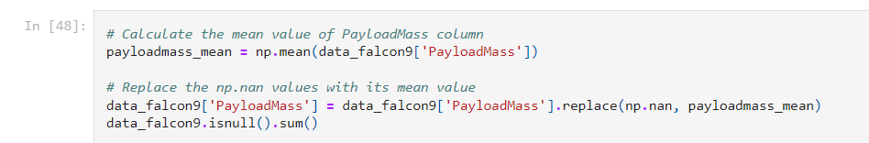
DATA COLLECTION WITH SPACEX API (result and Methodology)
I requested and parsed the SpaceX launch data using the GET request.
Then the data went through some cleaning.
I also filtered the Data frame to only include Falcon 9 launches
The missing values were dealt with by the Data Wrangling process.
Link to the notebook is: https://github.com/pchatrat/IBM_Capstone_Project/blob/main/Data%20Collection.ipynb

Slide 7
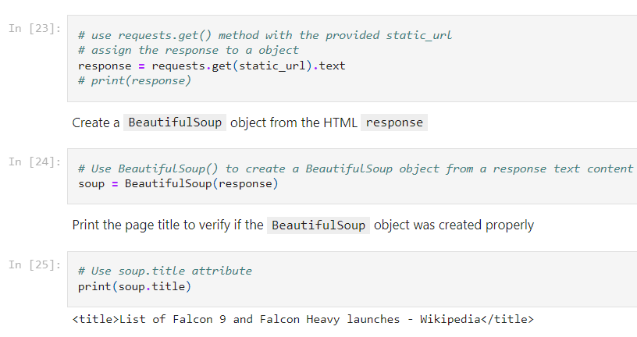
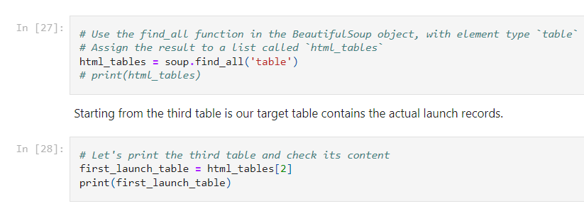
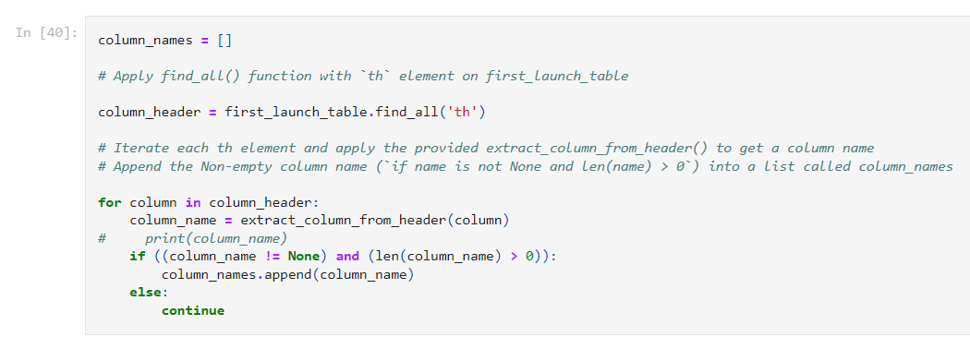
DATA COLLECTION WITH WEBSCRAPING (result and Methodology)
The data was collected from the Falcon 9 wiki page with help BeautifulSoup.
Then the data was converted to a Data frame with the help of Pandas by extracting the variable names from the HTML table header.
Link to the notebook is: https://github.com/pchatrat/IBM_Capstone_Project/blob/main/Data%20Collection%20with%20Web%20Scraping.ipynb

Slide 8
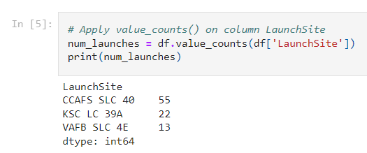
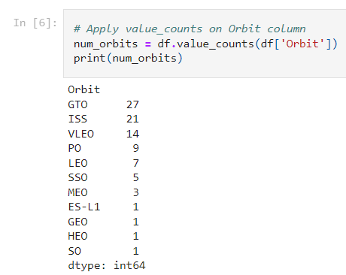
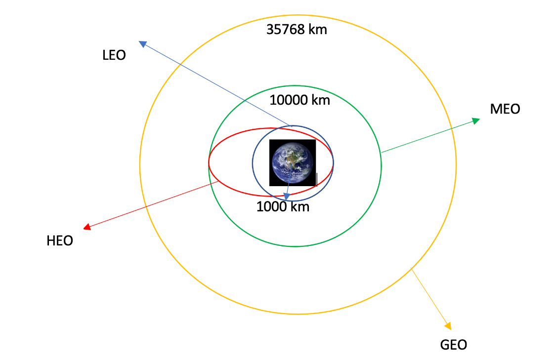
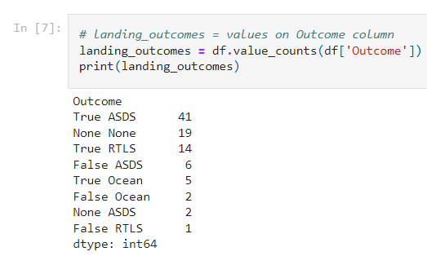
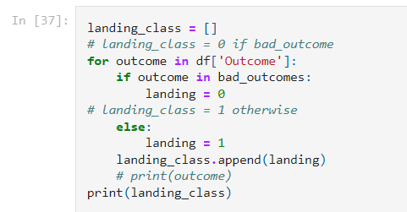
Data Wrangling (result and Methodology)
Using the data I calculated the number of launches on each site.
Then the data was leveraged to calculate the number and occurrences of each orbit depicted by the image.
I then calculated the number of occurrence of mission outcome per orbit.
Landing outcome label was created from Outcome column.
Link to the notebook is: https://github.com/pchatrat/IBM_Capstone_Project/blob/main/Spacex-Data%20wrangling.ipynb

Slide 9
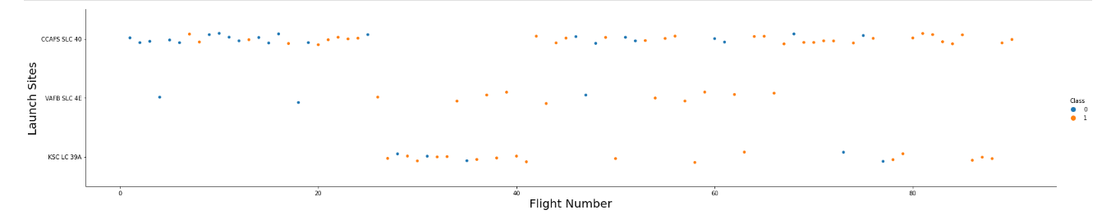
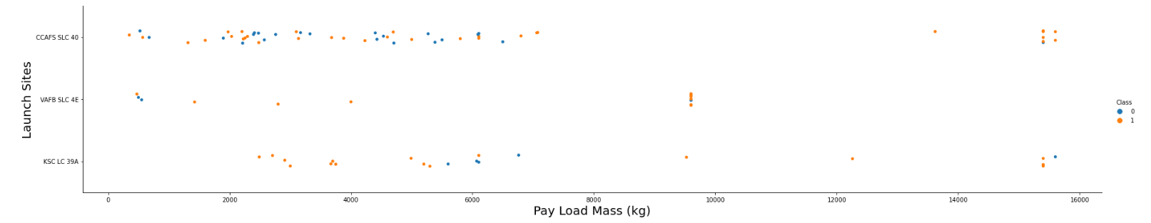
EXPLORATORY DATA ANALYTICS WITH VISUALIZATION (result and Methodology)
Relationship between Flight Number and Launch site was visualized.
The relationship between Payload and Launch site was visualized.
Link to the notebook is: https://github.com/pchatrat/IBM_Capstone_Project/blob/main/jupyter-labs-eda-dataviz.ipynb

Slide 10
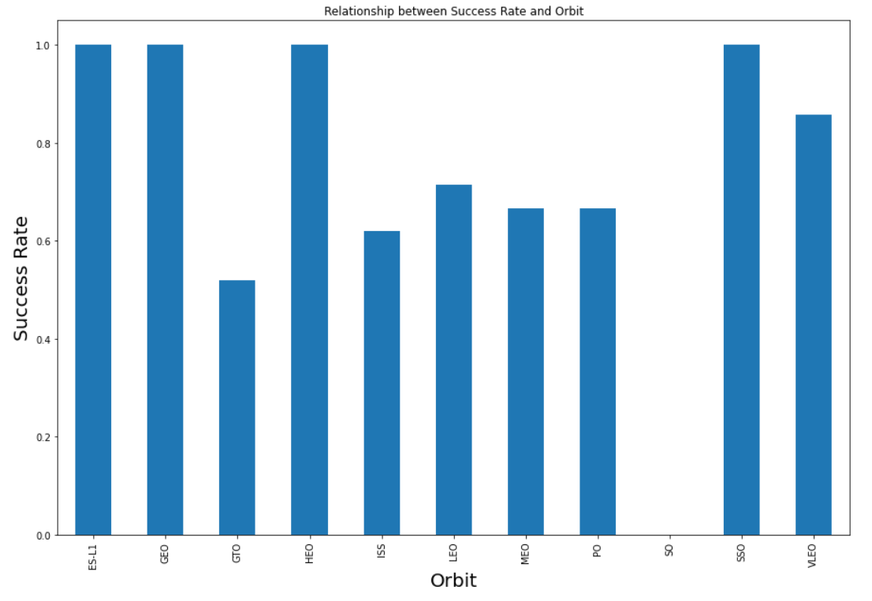
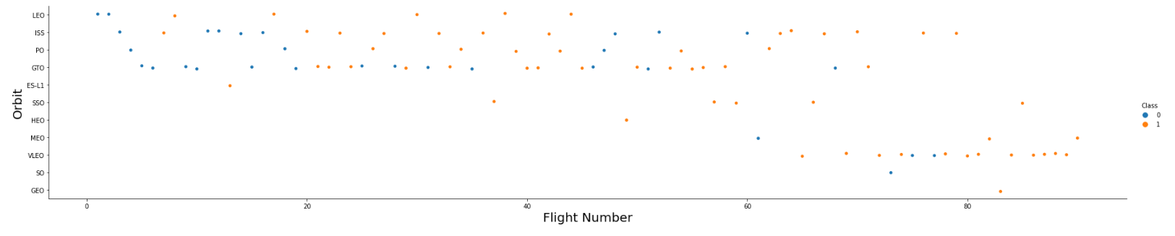
EXPLORATORY DATA ANALYTICS WITH VISUALIZATION (result and Methodology)
Relationship between the success rate of each orbit type was visualized.
The relationship between Flight Number and orbit type was visualized.
Link to the notebook is: https://github.com/pchatrat/IBM_Capstone_Project/blob/main/jupyter-labs-eda-dataviz.ipynb

Slide 11
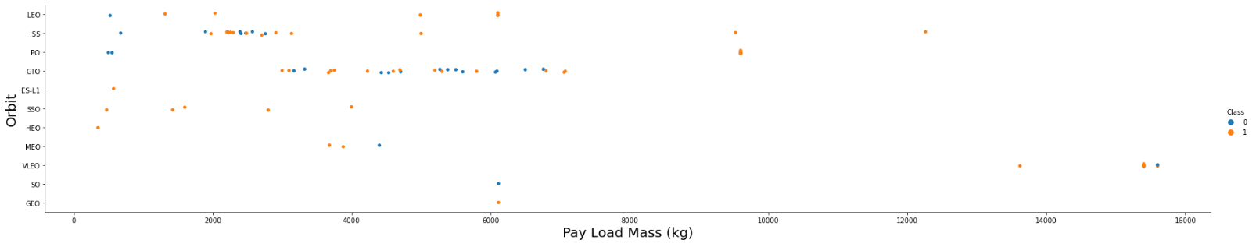
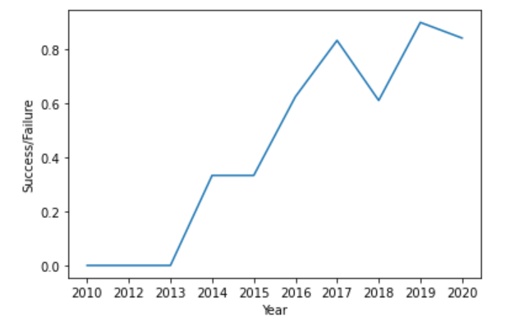
EXPLORATORY DATA ANALYTICS WITH VISUALIZATION (result and Methodology)
Relationship between the payload and orbit type was visualized.
Visualized the launch success yearly trend.
Link to the notebook is: https://github.com/pchatrat/IBM_Capstone_Project/blob/main/jupyter-labs-eda-dataviz.ipynb

Slide 12
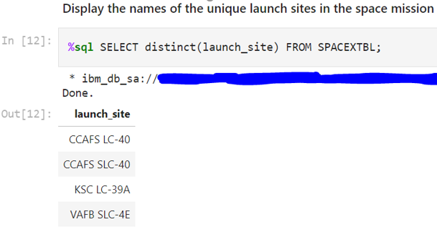
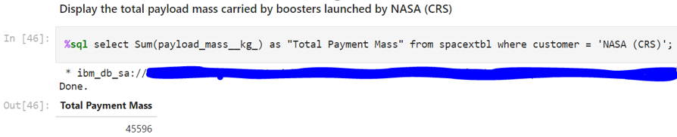
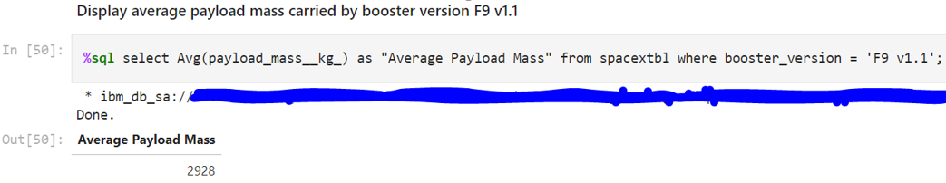
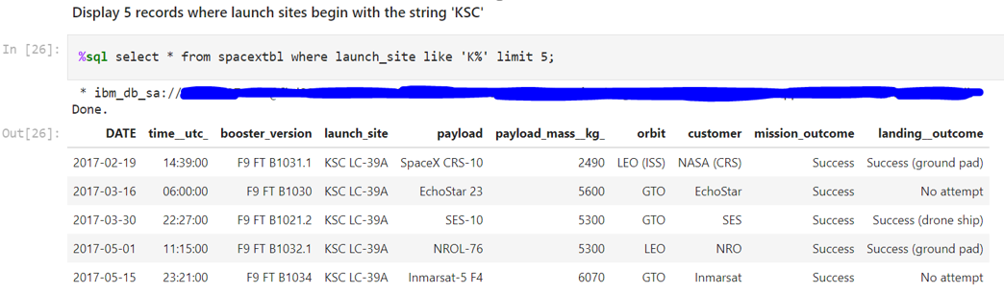
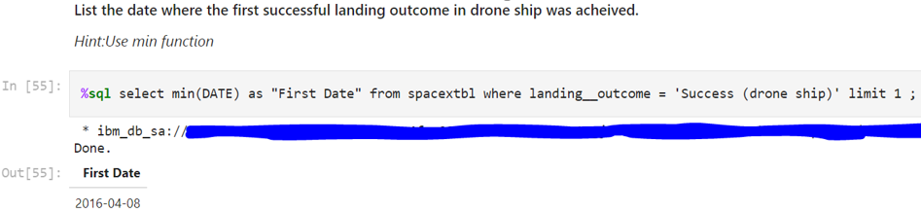
EXPLORATORY DATA ANALYTICS WITH SQL (result and Methodology)
Link to the notebook is: https://github.com/pchatrat/IBM_Capstone_Project/blob/main/jupyter-labs-eda-sql-edx.ipynb

Slide 13
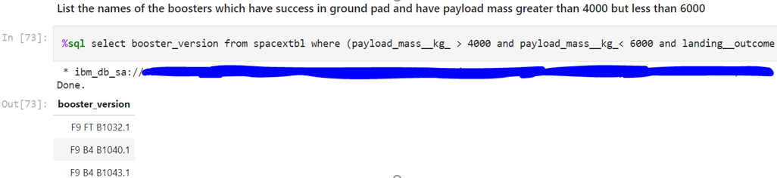
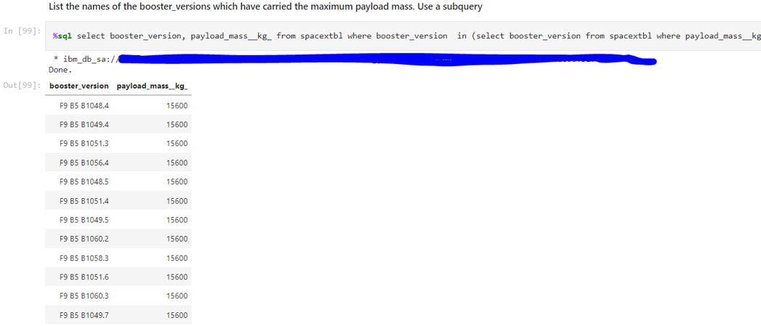
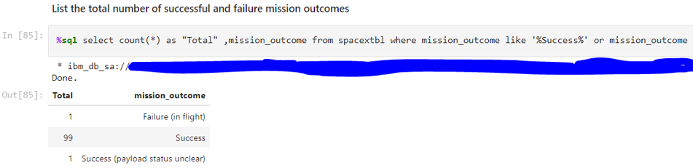
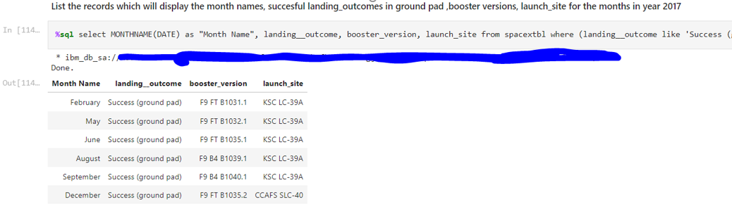
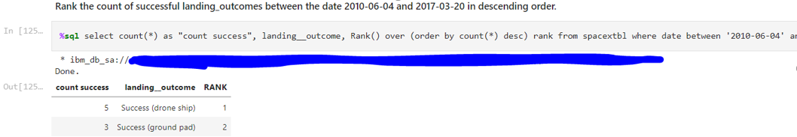
EXPLORATORY DATA ANALYTICS WITH SQL (result and Methodology)
Link to the notebook is: https://github.com/pchatrat/IBM_Capstone_Project/blob/main/jupyter-labs-eda-sql-edx.ipynb

Slide 14
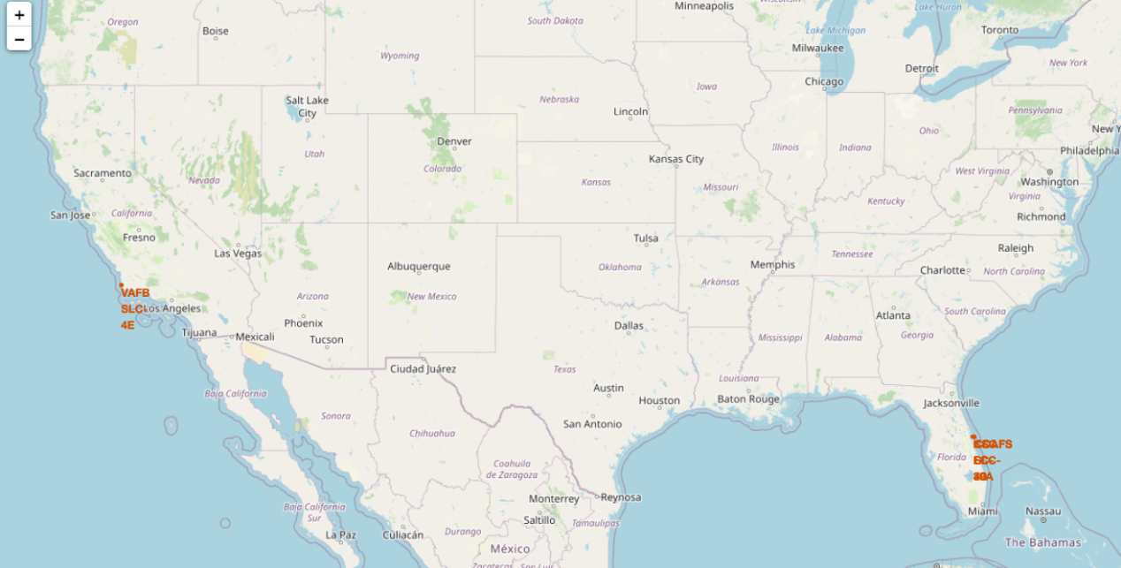
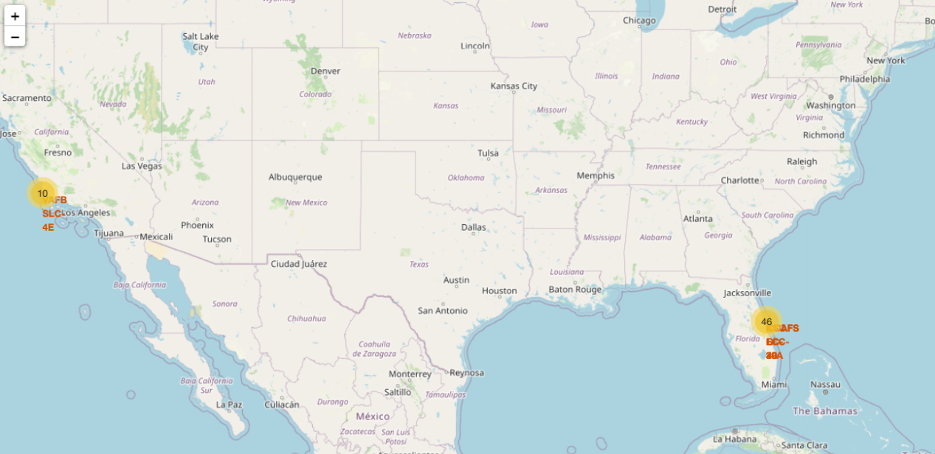
INTERACTIVE MAP WITH FOLIUM (result and Methodology)
Marked all the launch sites on the map generated by Folium.
Marked the Success/failed launches for each site on the map
Link to the notebook is: https://github.com/pchatrat/IBM_Capstone_Project/blob/main/lab_jupyter_launch_site_location.ipynb

Slide 15

INTERACTIVE MAP WITH FOLIUM (result and Methodology)
Calculate the launch site to its proximities distance.
Link to the notebook is: https://github.com/pchatrat/IBM_Capstone_Project/blob/main/lab_jupyter_launch_site_location.ipynb

Slide 16
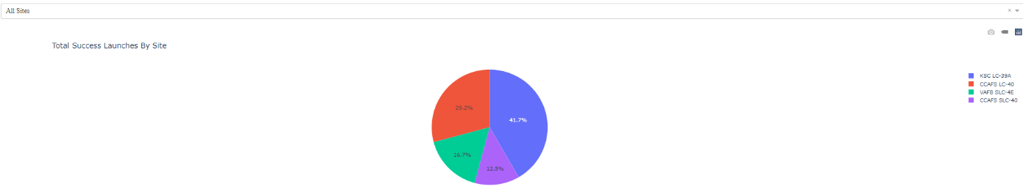
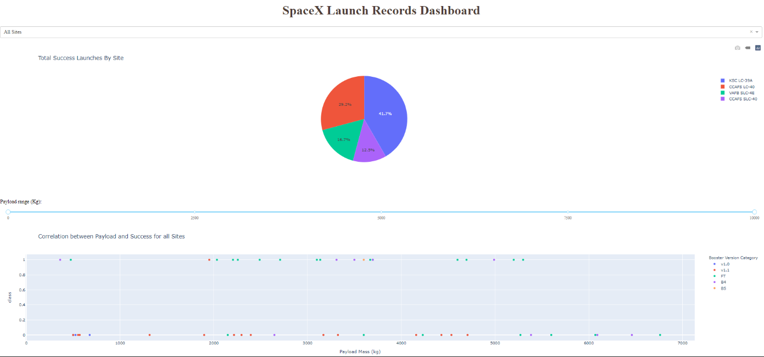
DASHBOARD WITH PLOTLY DASH (result and Methodology)
First the drop down input component was created.
Added a callback function which makes changes in the pie chart accordingly.
Then a range slider was added to select the Payload.
A callback function was added to render the success-payload-scatter-chart (scatter plot)
Link to the notebook is: https://github.com/pchatrat/IBM_Capstone_Project/blob/main/SpaceX%20Plotly.py

Slide 17
DASHBOARD INSIGHTS
Which site has the largest successful launches?
KSC LC-39A
Which site has the highest launch success rate?
KSC LC-39A had achieved 76.9%
Which payload range(s) has the highest launch success rate?
0-4000kg
Which payload range(s) has the lowest launch success rate?
4000kg-10000kg

Slide 18
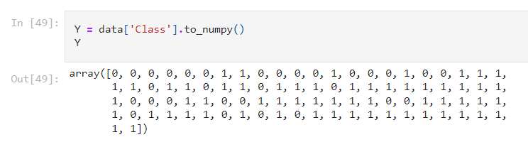
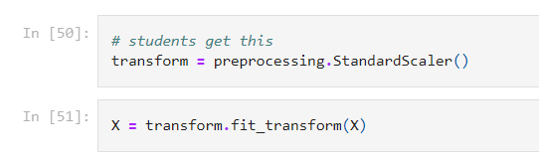
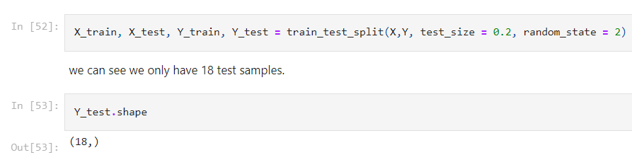
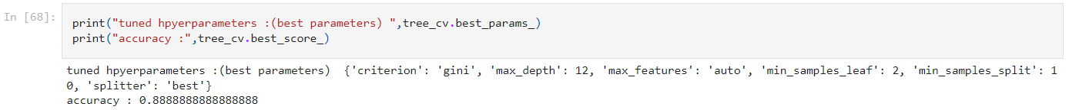
PREDICTIVE ANALYSIS CLASSIFICATION (result and Methodology)
Performed exploratory Data Analysis and determine Training Labels
Created a column for the class
Standardize the data
Split into training data and test data
Find best Hyperparameter for SVM, Classification Trees and Logistic Regression
Find the method performs best using test data
Link to the notebook is: https://github.com/pchatrat/IBM_Capstone_Project/blob/main/SpaceX_Machine%20Learning%20Prediction_Part_5%20(2).ipynb

Slide 19
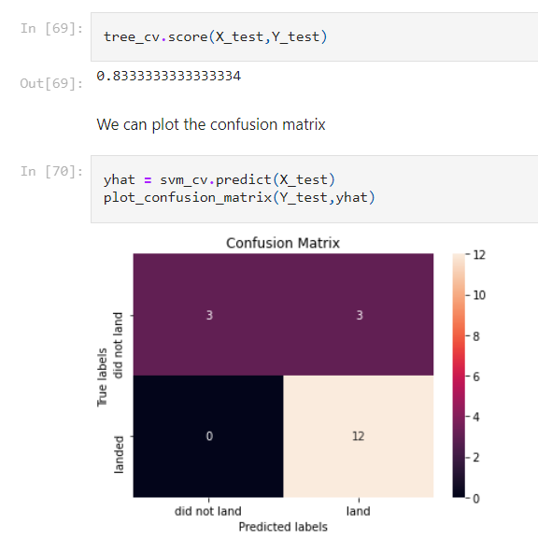
CONFUSION MATRIX
Link to the notebook is: https://github.com/pchatrat/IBM_Capstone_Project/blob/main/SpaceX_Machine%20Learning%20Prediction_Part_5%20(2).ipynb

Slide 20

CONCLUSION
The larger the flight amount at a launch site, the greater the success rate at a launch site.
Launch success rate started to increase in 2013 till 2020.
Orbits ES-L1, GEO, HEO, SSO, VLEO had the most success rate.
KSC LC-39A had the most successful launches of any sites.
The Decision tree classifier is the best machine learning algorithm for this task.

Slide 21

APPENDIX
All the code can be found in my Github repository below:-
https://github.com/pchatrat/IBM_Capstone_Project

